Slide 1

Market Microstructure Analyzer
Project Proposal Overview

Slide 2

01
Why did you choose this?
Computer Science + Finance

Slide 3

Functionalities
The Market Structure Analyzer will turn raw L1/L2 market order data into easy to read, queryable signals about how the market is behaving right now. Can send SNS texts/notifications during volatile times
What is L1/L2 market data?
L1: Top of the orderbook (best bid and best ask)
L2: Depth of the orderbook (a compilation of everything in between)
With this data, the program will compute microstructure calculations

Slide 4
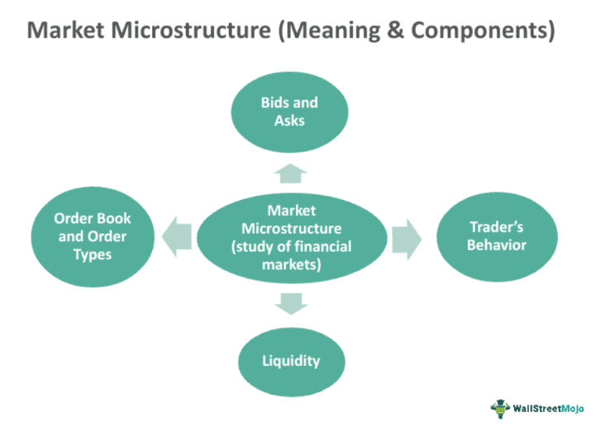
What is Microstructure Analysis?
Analyzing market structures is complex and requires automated tools to process data efficiently, offering real-time insights for decision-making.
Microstructure analysis studies how financial markets operate using volume, liquidity, transaction costs, spread, information asymmetry. This is used to understand market behavior and find trading opportunities.

Slide 5
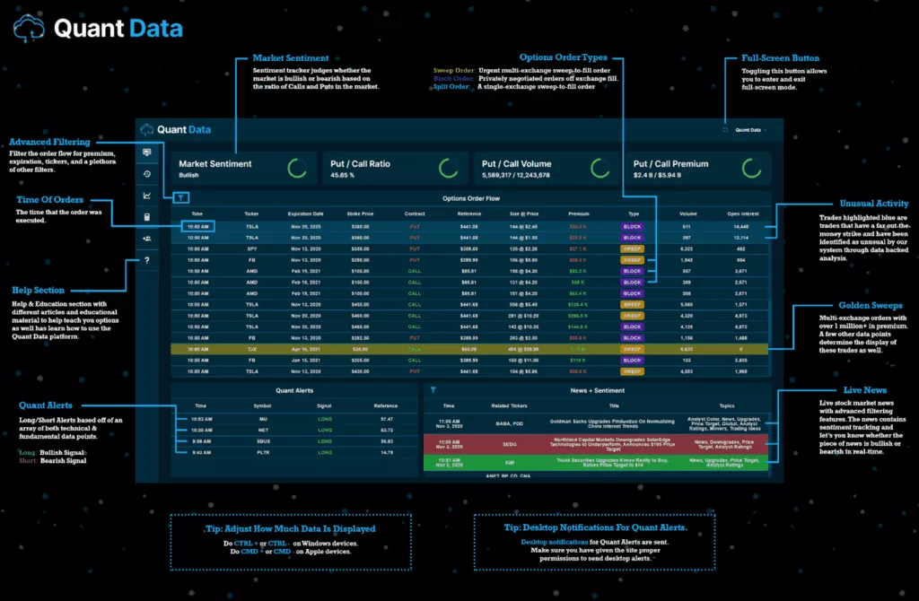
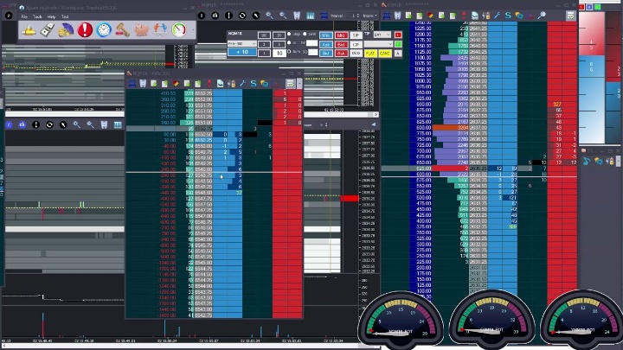
Competitors

Slide 6

Languages, Tools, Skills
Languages: Python, SQL
Skills: AWS, Linux, Financial Markets
Data: Cryptofeed
Front-end 2 options:
AWS Quicksight over Athena filters
React

Slide 7
Why should you work on this with me?
You should work on this with me if you’re interested in breaking into an area of computer science that is money-related whether that be business, finance, or banking.
It will hosted and operated on AWS a desireable skill
Linux will be apart of the project as well which is another good skill to learn

Slide 8
THANK YOU
Do you have any questions?
tul39810@temple.edu
+1 267 244 6993

